Slide 1

Epidemiological Studies – Part 1
Nina Gunnes
September 24, 2020

Slide 2
Types of epidemiological studies
Two main types of epidemiological studies
  Observational studies
  Experimental studies
Four types of observational studies
  Ecological studies
  Cross-sectional studies
  Case-control studies
  Cohort studies

Slide 3
Ecological studies
Study unit at population (or community level)
  Groups of individuals instead of individuals
Correlation study of different populations being a typical example
  Comparing occurrence of disease with mean exposure
Several advantages
  Inexpensive
  Exposure at population level more stable than at individual level
  Potentially big contrasts in exposure between populations

Slide 4
Ecological studies, cont.
Great weaknesses
  Exposure and disease measured at group level (exposed becoming diseased?)
  Not possible to control for confounding at individual level
Cannot alone establish association between exposure and disease
  Providing important hypotheses
  Must be verified by using other study designs

Slide 5
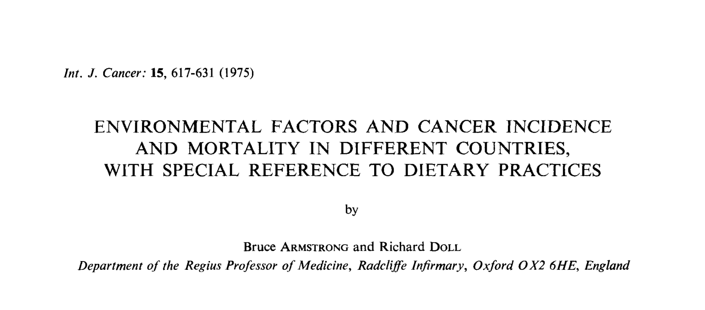
Example 10.5 in Aalen et al. (2006)

Slide 6
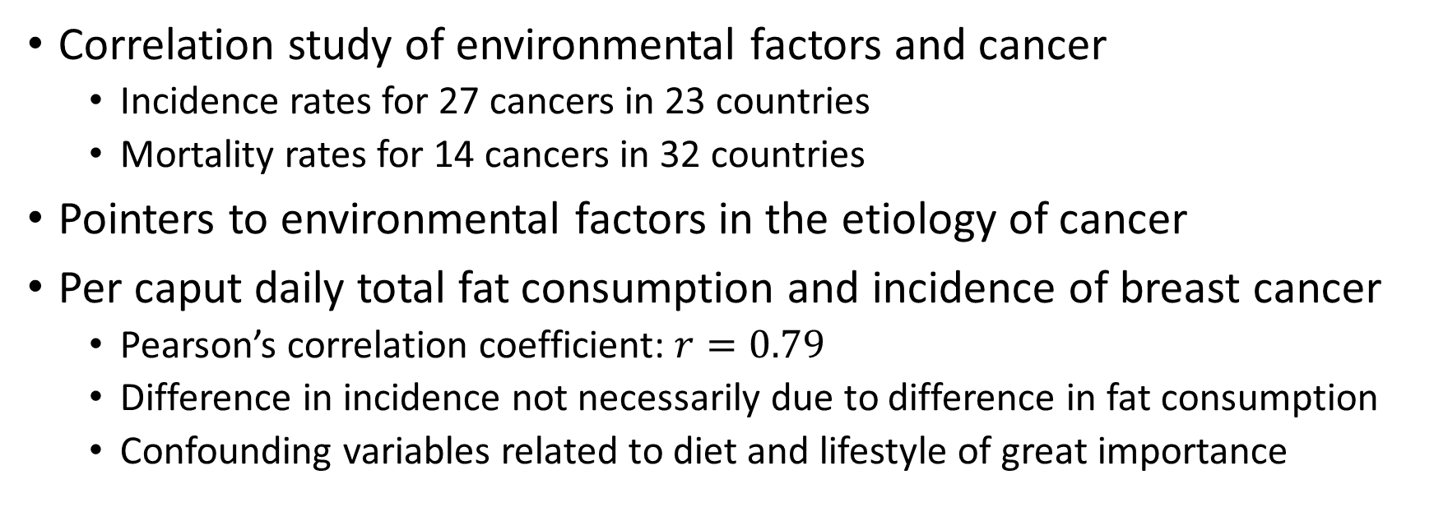
Example 10.5 in Aalen et al. (2006), cont.
Correlation study of environmental factors and cancer
  Incidence rates for 27 cancers in 23 countries
  Mortality rates for 14 cancers in 32 countries
Pointers to environmental factors in the etiology of cancer
Per caput daily total fat consumption and incidence of breast cancer
  Pearson’s correlation coefficient: $r=0.79$
  Difference in incidence not necessarily due to difference in fat consumption
  Confounding variables related to diet and lifestyle of great importance

Slide 7
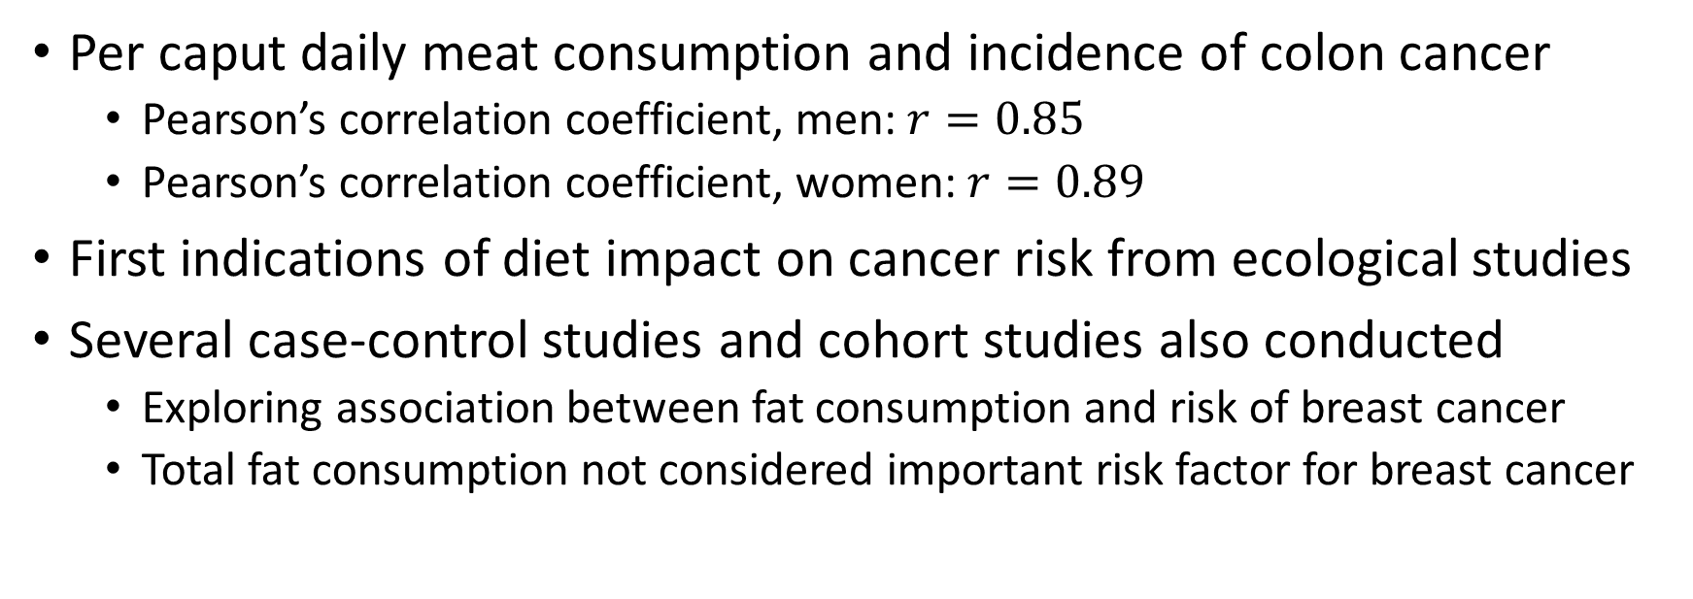
Example 10.5 in Aalen et al. (2006), cont.
Per caput daily meat consumption and incidence of colon cancer
  Pearson’s correlation coefficient, men: $r=0.85$
  Pearson’s correlation coefficient, women: $r=0.89$
First indications of diet impact on cancer risk from ecological studies
Several case-control studies and cohort studies also conducted
  Exploring association between fat consumption and risk of breast cancer
  Total fat consumption not considered important risk factor for breast cancer

Slide 8
Cross-sectional studies
Measuring prevalence of disease or risk factor at a particular time
Some obvious benefits
  Relatively quick, inexpensive, and easy to understand
  Can be standardized
  Possible to examine many variables in the same study
Several weaknesses
  Cannot estimate risk of disease
  Can only establish association between exposure and disease – not causality

Slide 9
Cross-sectional studies, cont.
Important findings must be checked by using other study designs
Observed changes over time by repeated cross-sectional studies
  May reflect real time trends
  Findings due to differences between participants at different times?

Slide 10
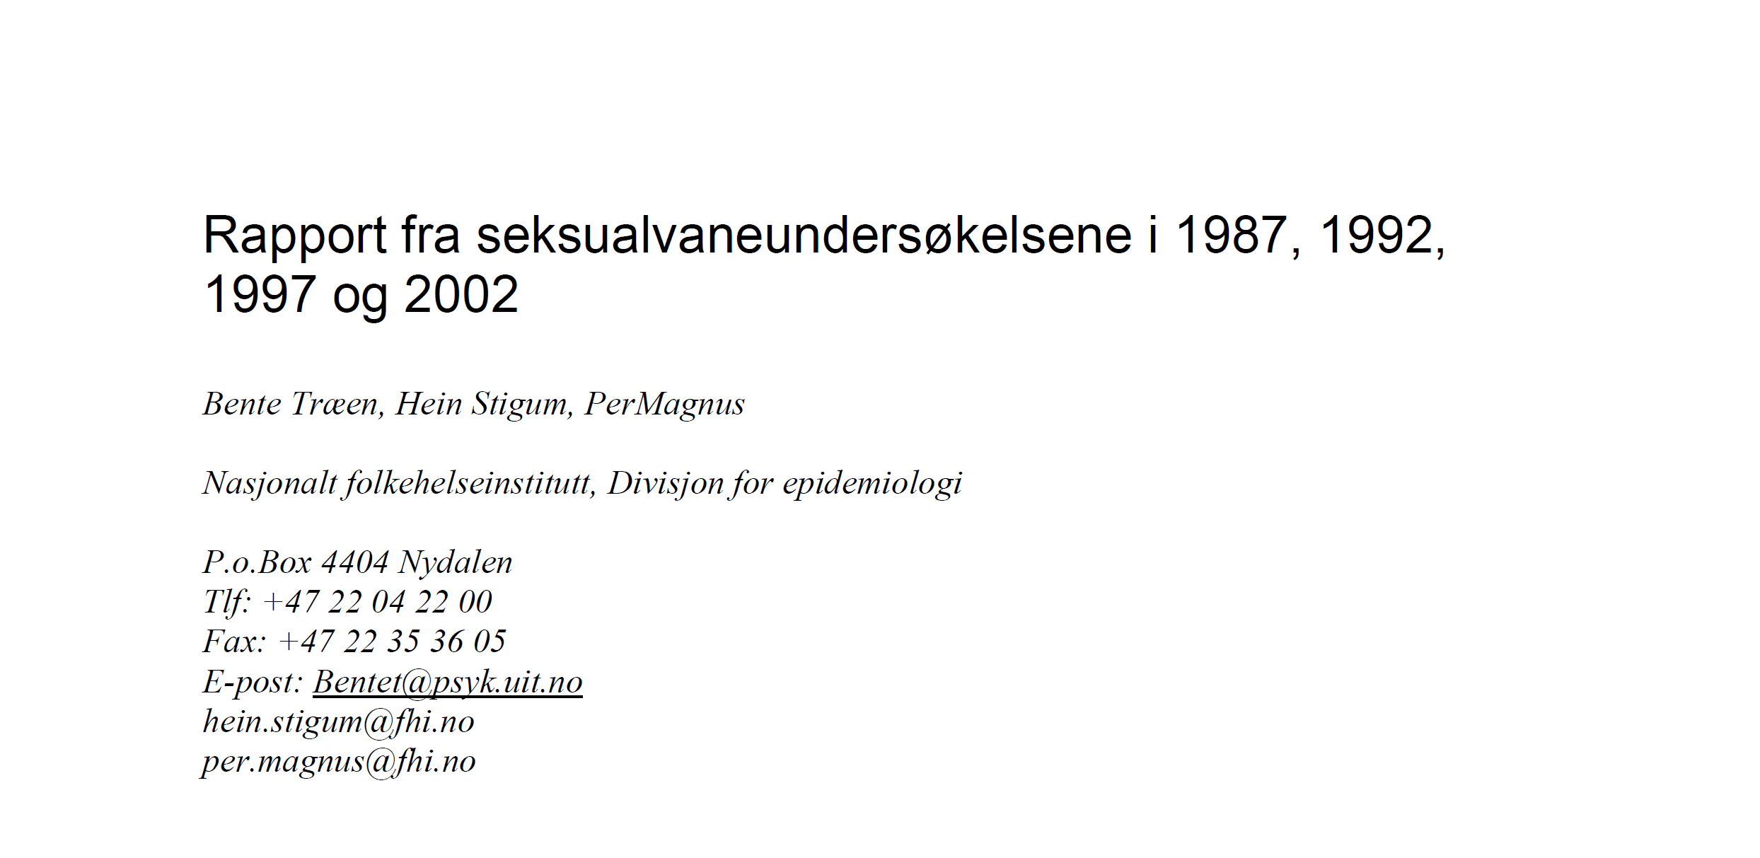
Example 10.6 in Aalen et al. (2006)

Slide 11
Example 10.6 in Aalen et al. (2006), cont.
Repeated cross-sectional studies on sexual habits (1987–2002)
  Norwegian Institute of Public Health
  https://www.fhi.no/publ/eldre/rapport-fra-seksualvane-undersokels/
Obtaining knowledge about sexual habits of the population
  Understanding, predicting, and preventing sexually transmitted diseases
  Preventing unwanted pregnancies
Surveys conducted at 5-year intervals
  Four questionnaires in 1987, 1992, 1997, and 2002

Slide 12
Example 10.6 in Aalen et al. (2006), cont.
Questionnaire in 2002
  Sent out to 10,000 subjects aged 18–49 years
  Response rate of 36%
  95.6% of males and 96.8% of females having had sexual intercourse
Main conclusions on time trends based on all questionnaires
  People more sexually active
  Decreased age of sexual debut
  Increased proportion of subjects with homosexual experience

Slide 13
Case-control studies
Based on groups of subjects with and without disease
  Cases
  Controls
Controls representing the base population of the cases
Exploring whether exposure in the two groups differ
  Registration of exposure for each subject
Retrospective
  Going back in time to obtain information about exposure

Slide 14
Case-control studies, cont.
Great advantages
  Easy, quick, and inexpensive
  Well suited for rare diseases
  Several exposures possible
  Drop-out avoided
Exposures registered after diagnosis of disease
  Subjects more or less likely to recall prior exposure depending on outcome?
  Potential recall bias!

Slide 15
Case-control studies, cont.
Investigator knowing disease status of the subjects
  More intense interrogation of cases regarding exposure?
Some further disadvantages
  Unsuited for rare exposures
  Restricted to only one disease
  Estimation of disease occurrence (prevalence and incidence) not possible
Odds ratio as effect measure
  Interpreted as relative risk for rare diseases

Slide 16
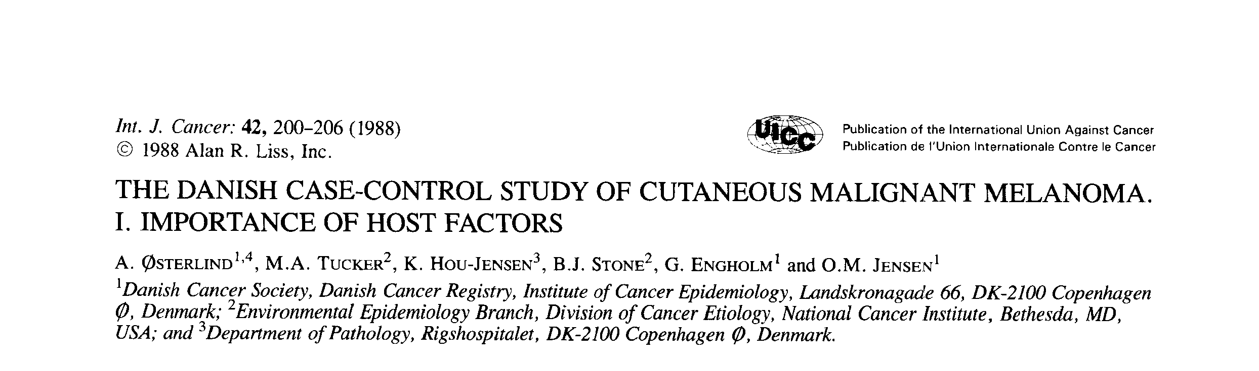
Example 10.7 in Aalen et al. (2006)

Slide 17
Example 10.7 in Aalen et al. (2006), cont.
Danish case-control study of malignant melanoma
  Cases of newly diagnosed patients aged 20–79 years
  Controls in the same age group and from the same geographical area
Investigating risk factors of malignant melanoma
Cases and controls interviewed about exposures
  Number of raised nevi (moles) on the arms
  …
Constructing a two-by-two table

Slide 18
Example 10.7 in Aalen et al. (2006), cont.
 | Number of raised nevi on the arms
 | 5+ | 0
Cases | 76 | 231
Controls | 39 | 635

Slide 19
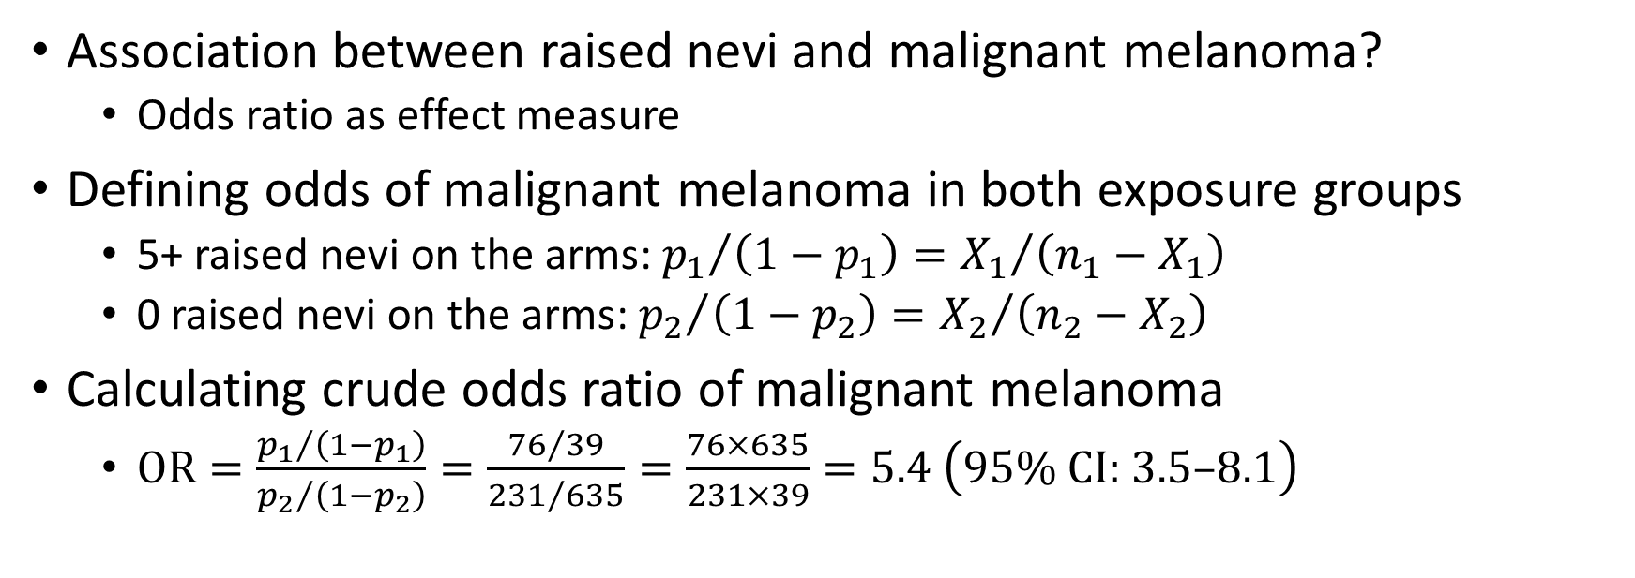
Example 10.7 in Aalen et al. (2006), cont.
Association between raised nevi and malignant melanoma?
  Odds ratio as effect measure
Defining odds of malignant melanoma in both exposure groups
  5+ raised nevi on the arms: ${p_{1}}/{\left(1−p_{1}\right)={X_{1}}/{\left(n_{1}−X_{1}\right)}}$
  0 raised nevi on the arms: ${p_{2}}/{\left(1−p_{2}\right)={X_{2}}/{\left(n_{2}−X_{2}\right)}}$
Calculating crude odds ratio of malignant melanoma
  $\text{OR}=\frac{{p_{1}}/{\left(1−p_{1}\right)}}{{p_{2}}/{\left(1−p_{2}\right)}}=\frac{{76}/{39}}{{231}/{635}}=\frac{76×635}{231×39}=5.4 \left(95\% \text{CI}\text{:} 3.5\text{–}8.1\right)$

Slide 20
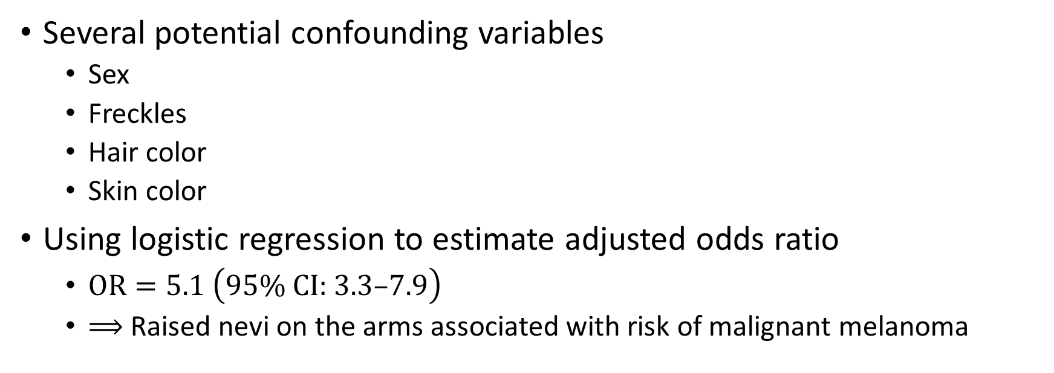
Example 10.7 in Aalen et al. (2006), cont.
Several potential confounding variables
  Sex
  Freckles
  Hair color
  Skin color
Using logistic regression to estimate adjusted odds ratio
  $\text{OR}=5.1 \left(95\% \text{CI}\text{:} 3.3\text{–}7.9\right)$
  $⟹$ Raised nevi on the arms associated with risk of malignant melanoma

Slide 21
References
Aalen OO, Frigessi A, Moger TA, Scheel I, Skovlund E, Veierød MB. 2006. Statistiske metoder i medisin og helsefag. Oslo: Gyldendal akademisk.
Armstrong B, Doll R. Environmental factors and cancer incidence and mortality in different countries, with special reference to dietary practices. Int J Cancer. 1975;15(4):617-631. doi:10.1002/ijc.2910150411
Osterlind A, Tucker MA, Hou-Jensen K, Stone BJ, Engholm G, Jensen OM. The Danish case-control study of cutaneous malignant melanoma. I. Importance of host factors. Int J Cancer. 1988;42(2):200-206. doi:10.1002/ijc.2910420210.
Træen B, Stigum H, Magnus P. Rapport fra seksualvaneundersøkelsene i 1987, 1992, 1997 og 2002. Norwegian Institute of Public Health. 2003. https://www.fhi.no/publ/eldre/rapport-fra-seksualvane-undersokels/.

